Slide 1
Tesco: Review of performance and opportunities
Annabel Sill

Slide 2


Slide 5
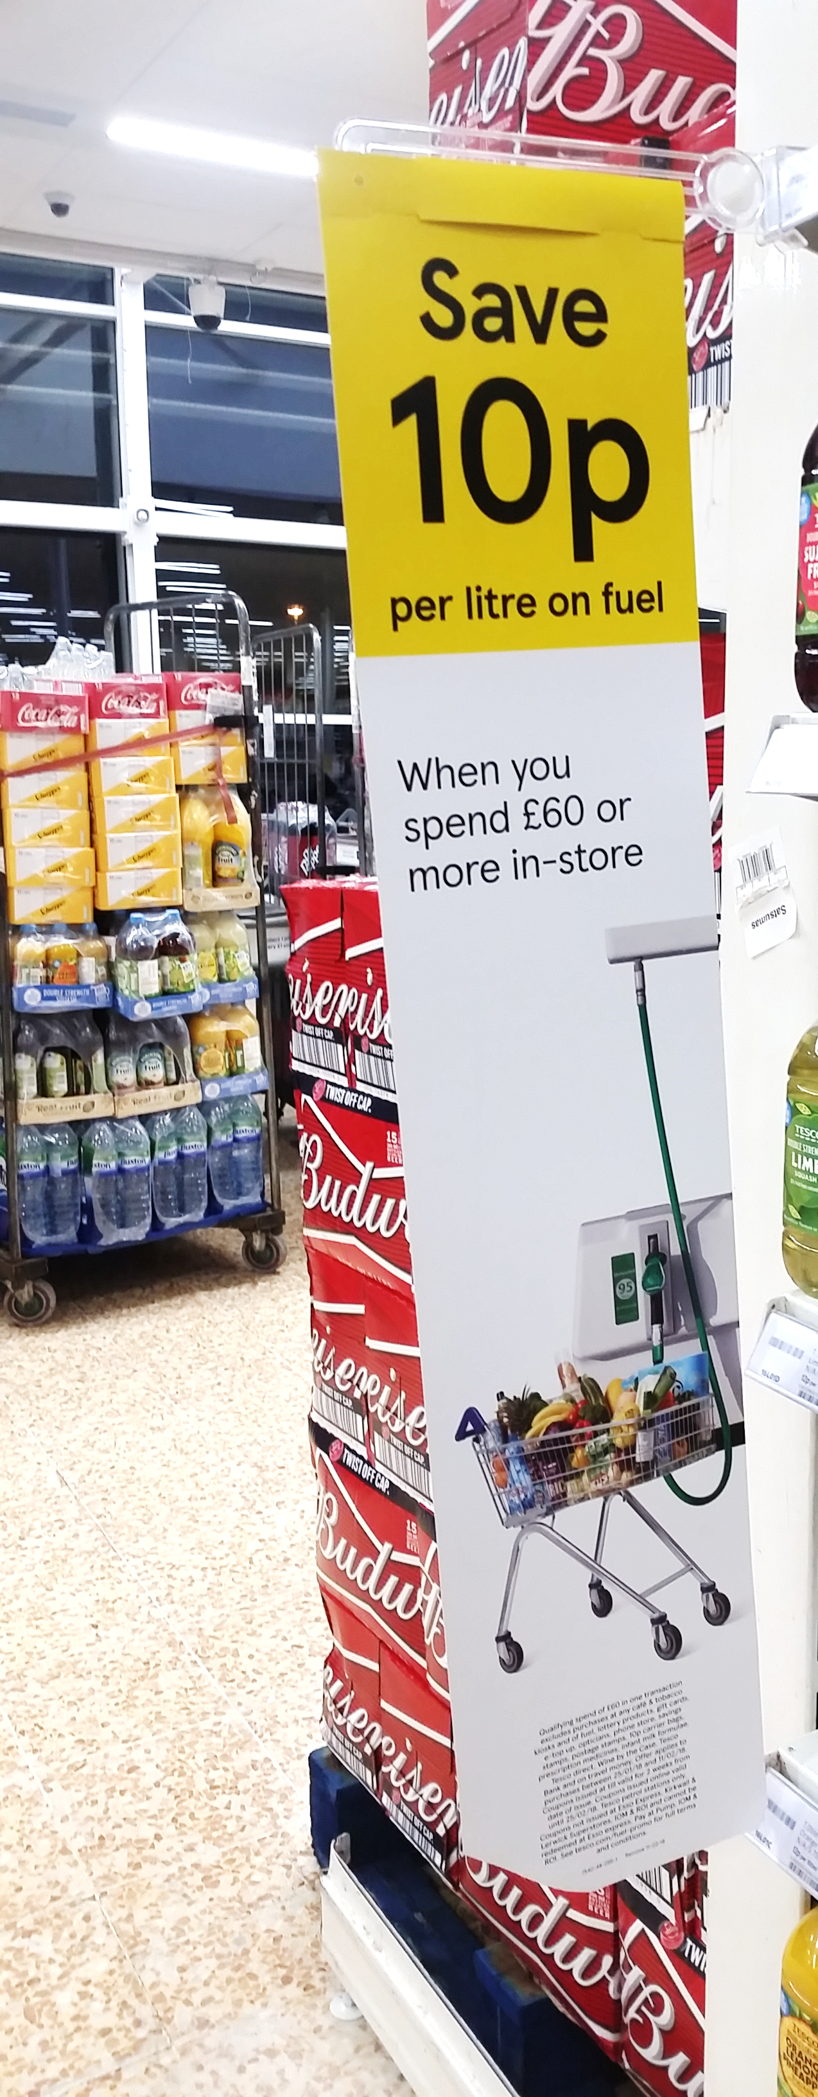
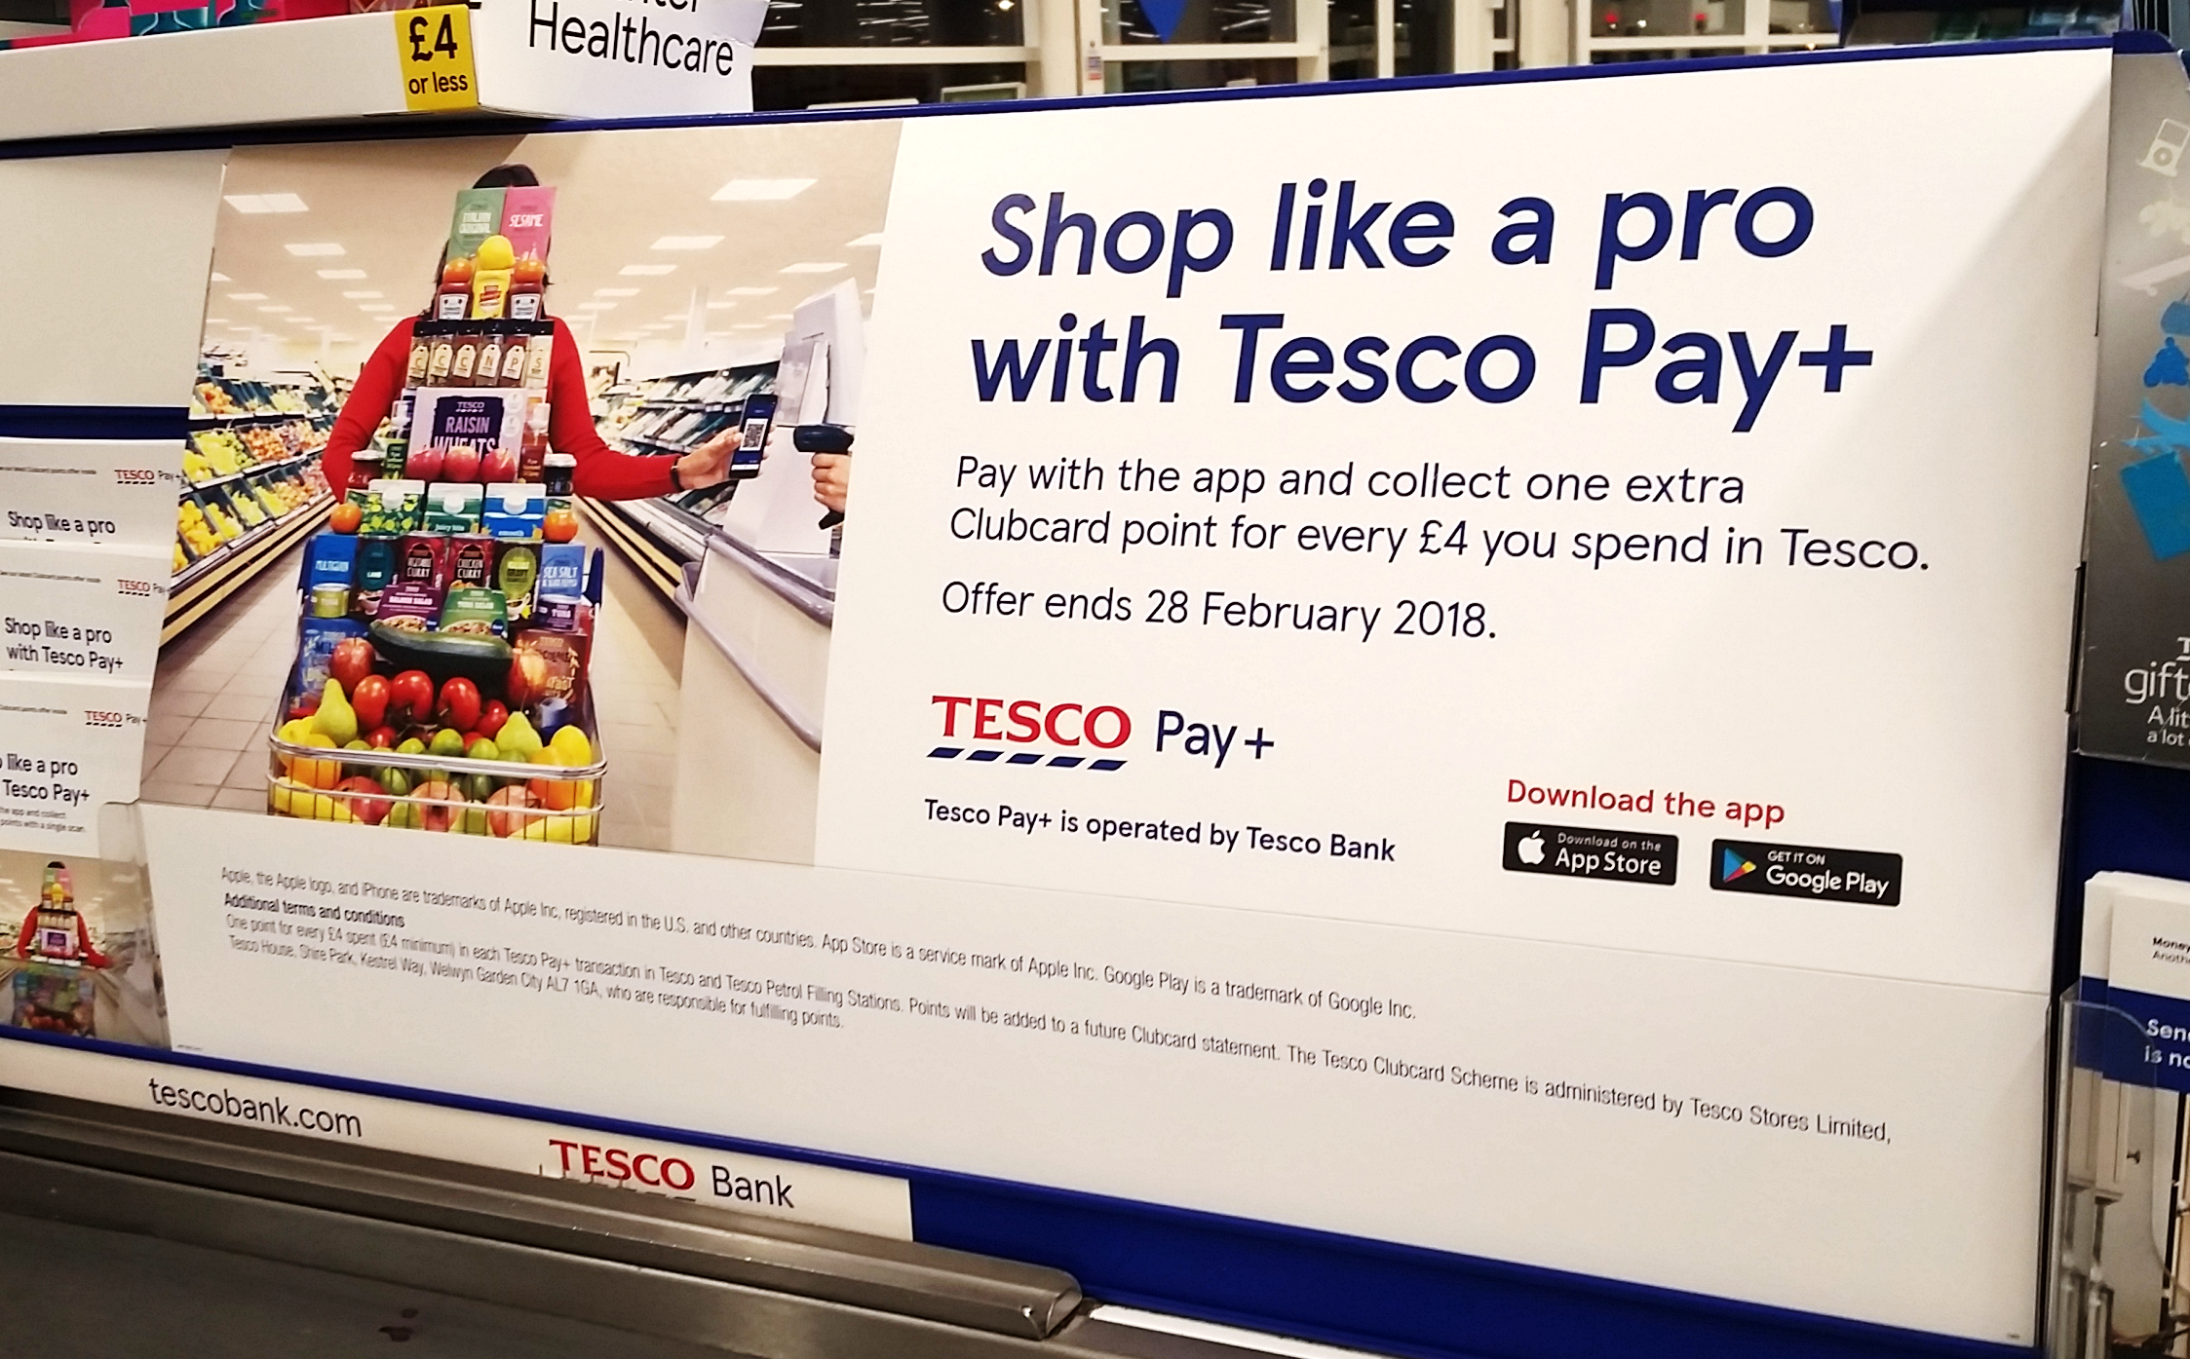

What are they doing to win?
Brand Guarantee and financial incentives
Ease of shop
Quality of own brand products
Notes:
Pay+ is the only payment app that combines club card and payment

Slide 6
Categories and consumer trends driving Tesco’s growth

Slide 7
Food Love Stories campaign
Healthier living for customers

Slide 8
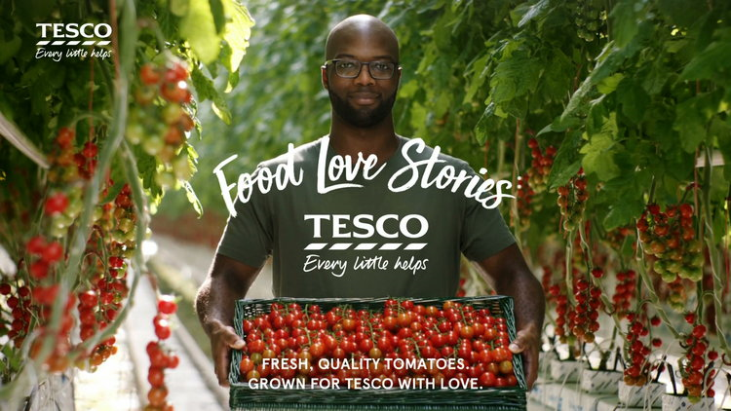
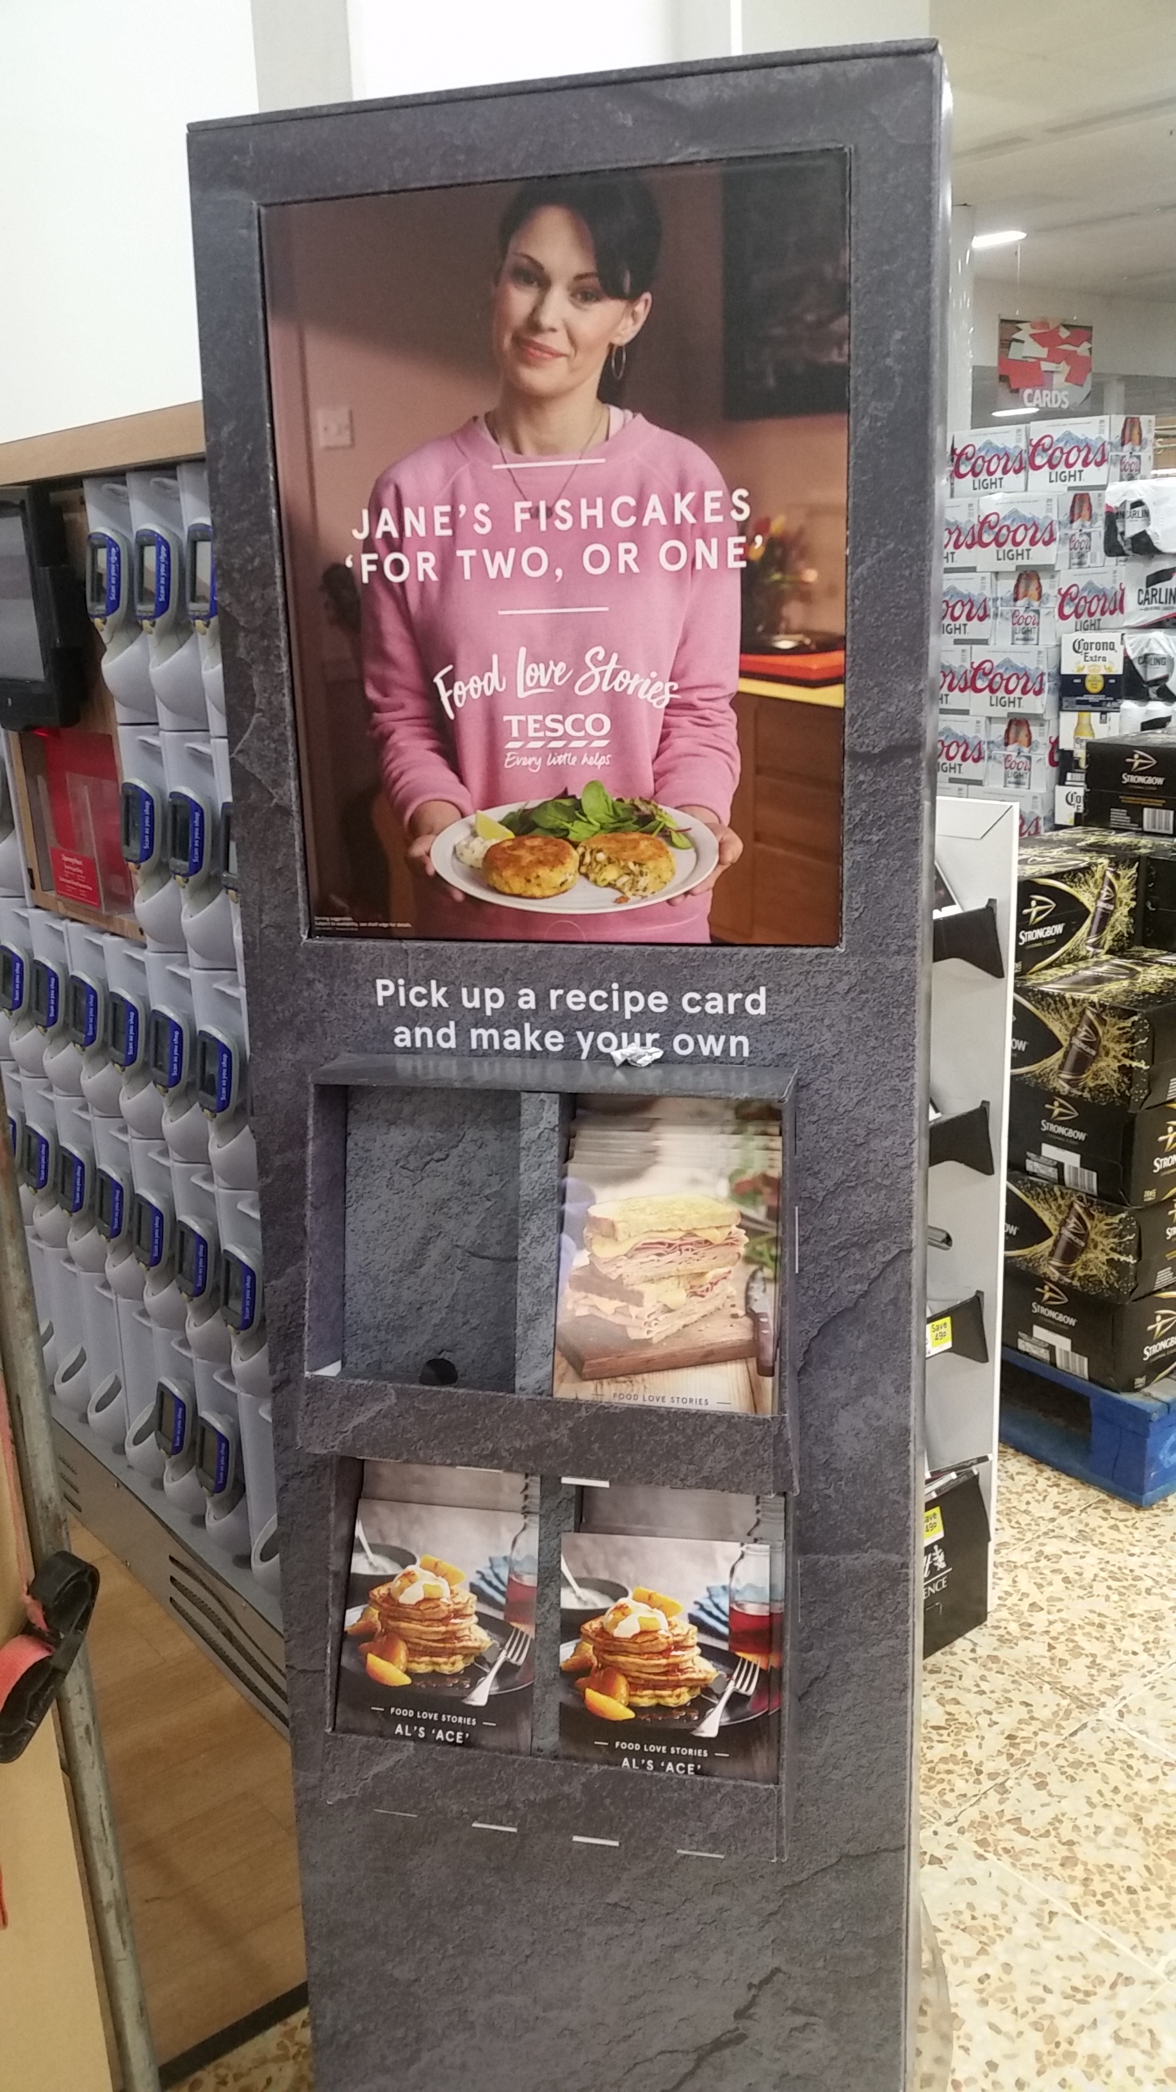
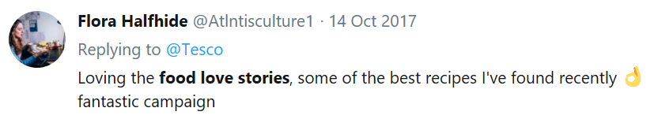
Food Love Stories
Launched January 2017
Seasonal recipes with strong personal theme
Wide-ranging consistent marketing
Builds customer confidence in Tesco’s passion for food and sourcing
Notes:
Seasonal – keeps the campaign dynamic and relevant
Stories accompanying recipes – good ‘personal’ touch, customers can relate to the characters. Strong family theme Marketing – TV, magazine, in store stands, end of aisle to buy ingredient to accompany recipes
Builds trust – consumers associate Tesco with passion for food and sourcing

Slide 9
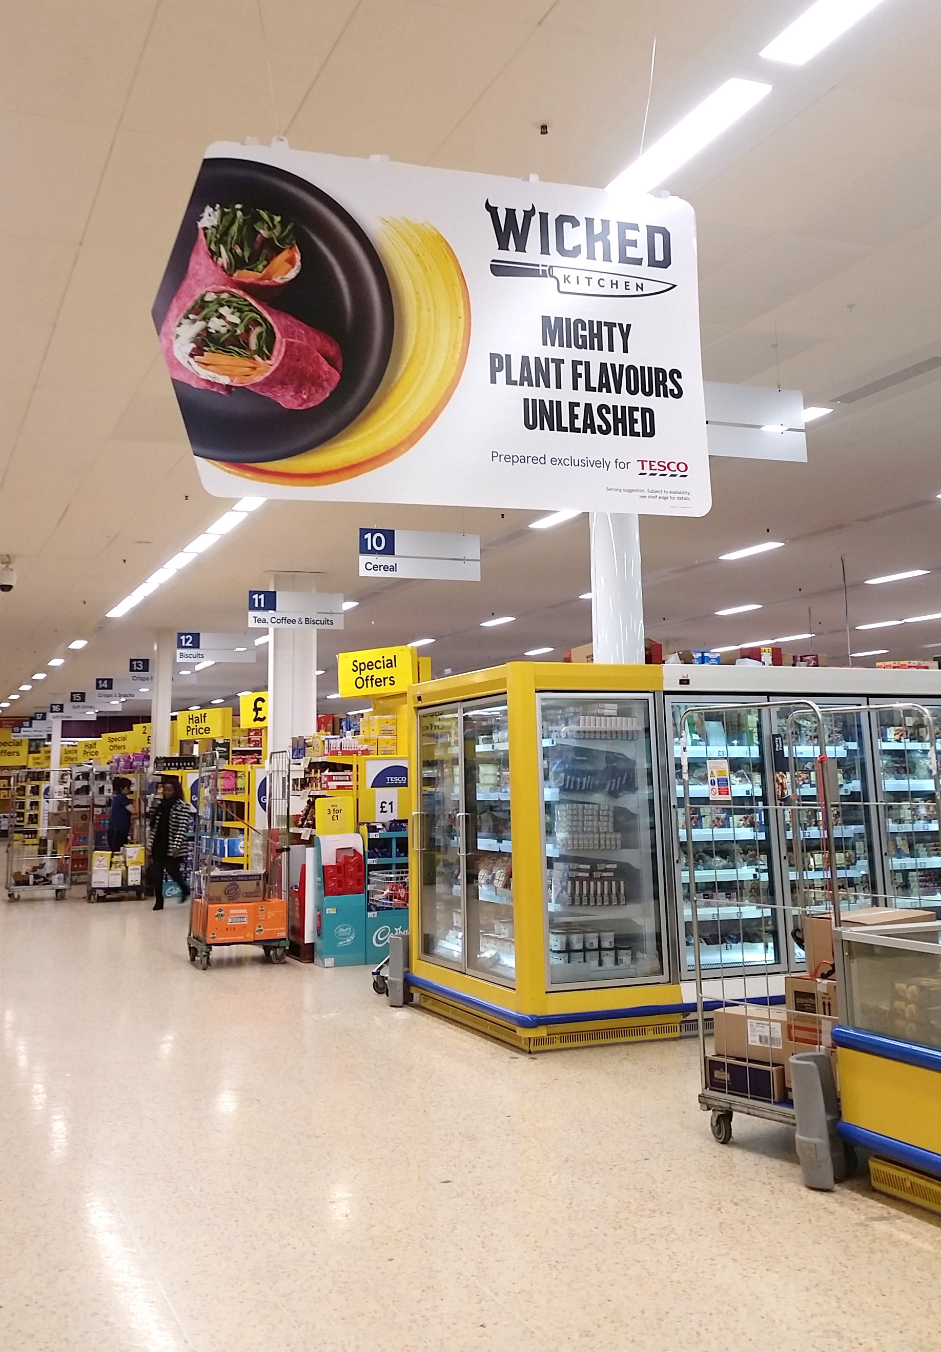

Healthier living
Food swaps
‘Little Helps to Healthier Living’
In store free fruit for children
Newly launched Wicked range of vegan meals and food to go

Slide 10
Innovation

Slide 11
Quorn: opportunities in Tesco

Slide 12
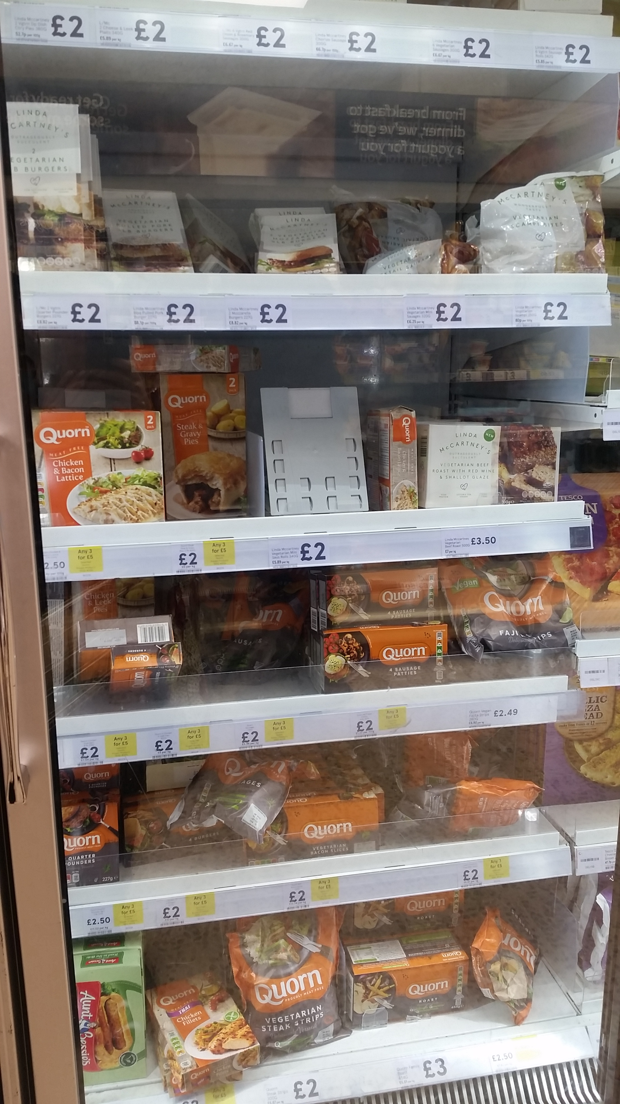
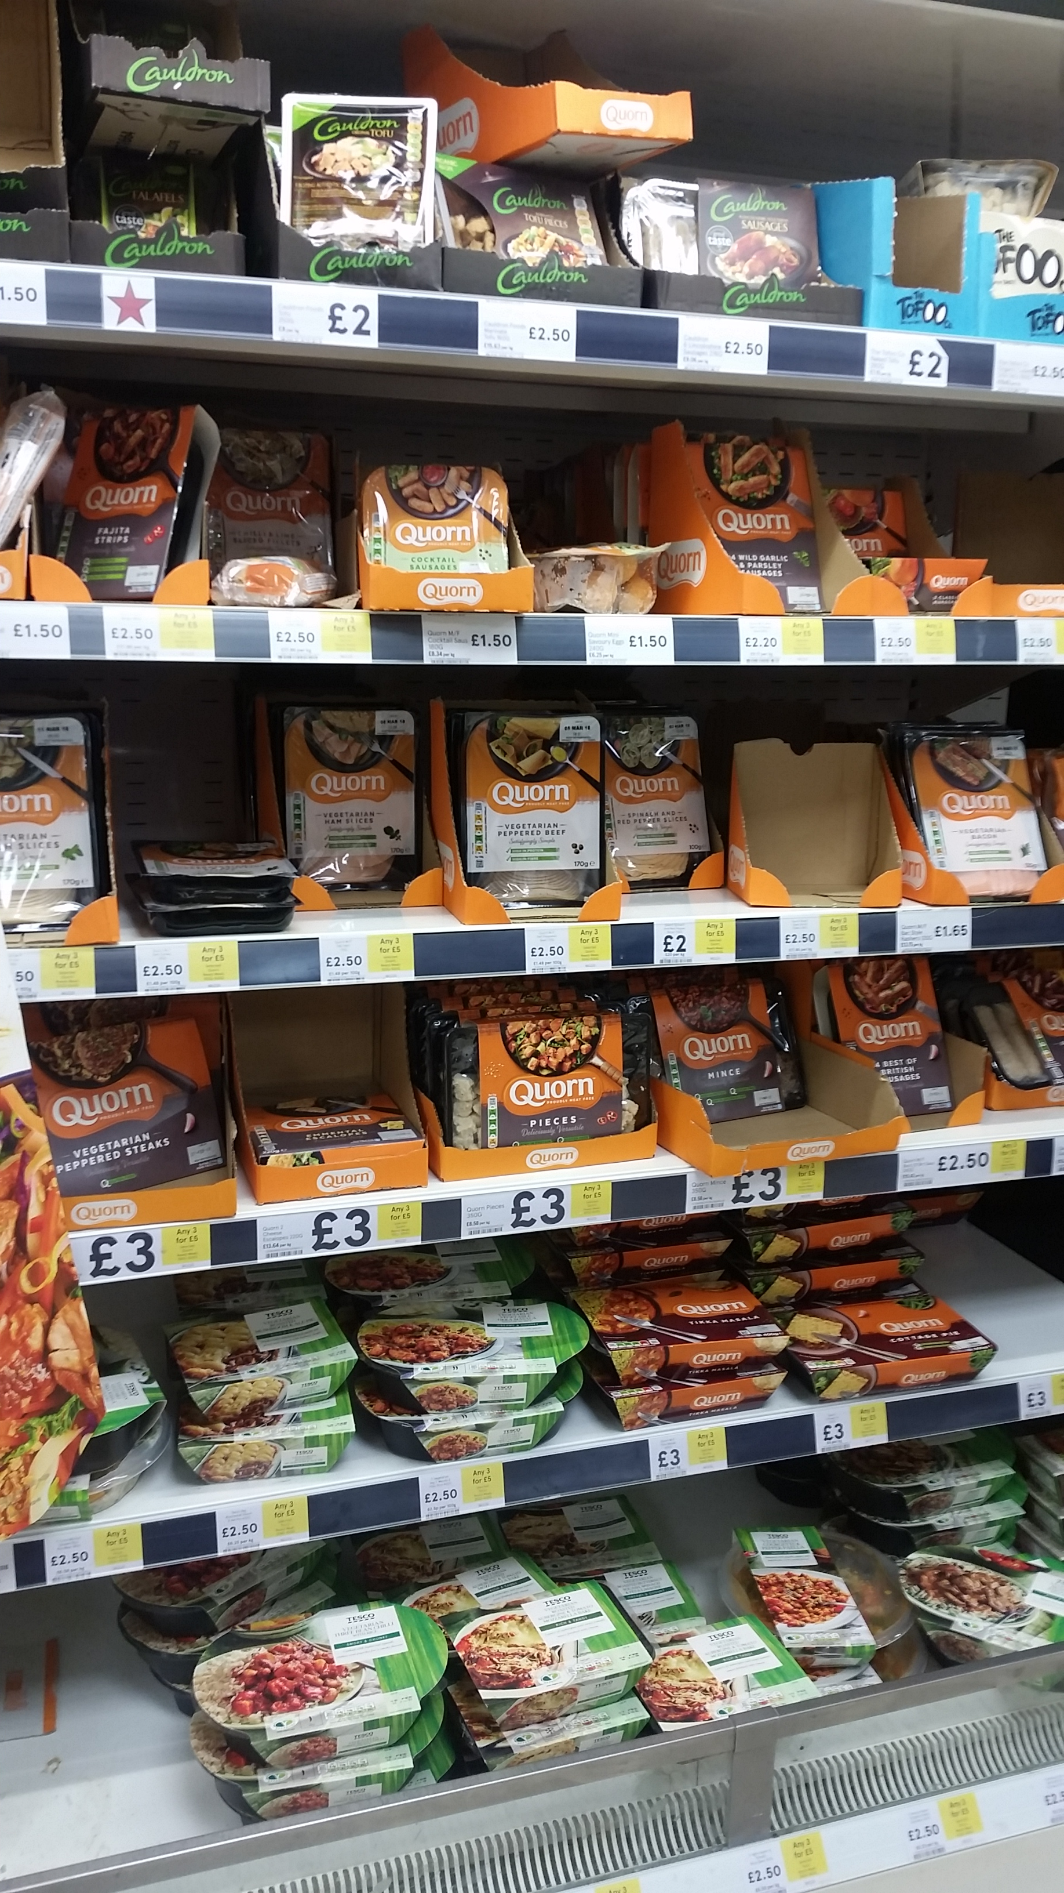
Quorn holds a strong position in store with shelf space in chilled and ambient
Chilled range is more extensive than competitor offering
Multi buy ‘3 for £5’ offer within both chilled and frozen includes Tesco own brand range
Quorn frozen range is divided between ‘Free From’ vegan SKUs, and vegetarian SKUs

Slide 13
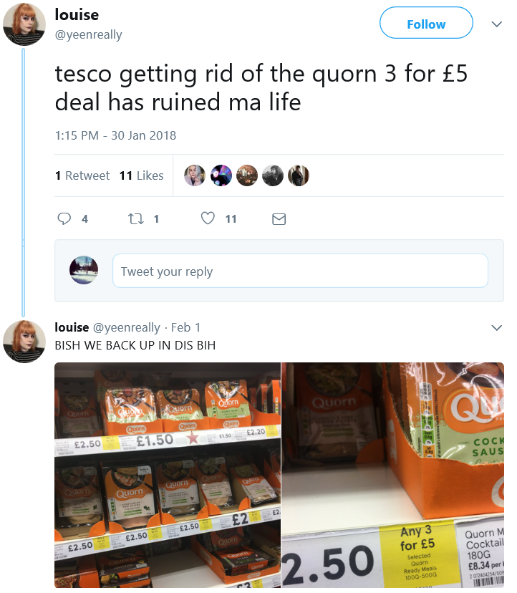
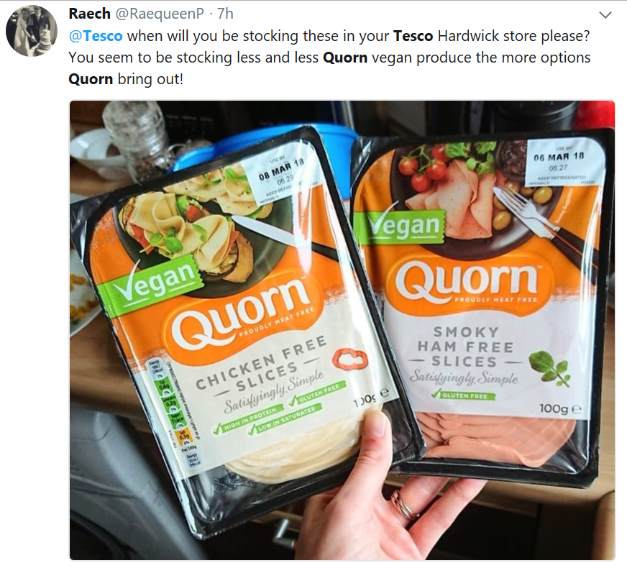
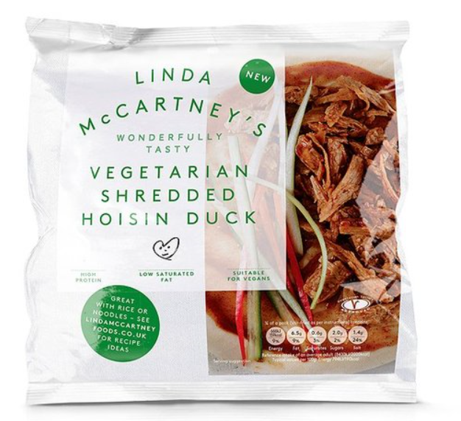
Multibuy offer
Maximising ranging of lines
NPD to appeal to flexitarian consumer tastes
Notes:
Multibuy offer – drives volume, encourages purchasing of multiple products

